Slide 1
Chapter 20
Security and Administration
Transparencies
Pearson Education © 2009

Slide 2
Chapter 20 - Objectives
The scope of database security.
Why database security is a serious concern for an organization.
The type of threats that can affect a database system.
Pearson Education © 2009

Slide 3
Chapter 20 - Objectives
How to protect a computer system using computer-based controls.
The security measures provided by Microsoft Office Access and Oracle DBMSs.
Approaches for securing a DBMS on the Web.
Pearson Education © 2009

Slide 4
Database Security
Data is a valuable resource that must be strictly controlled and managed, as with any corporate resource.
Part or all of the corporate data may have strategic importance and therefore needs to be kept secure and confidential.
Pearson Education © 2009

Slide 5
Database Security
Mechanisms that protect the database against intentional or accidental threats.
Security considerations do not only apply to the data held in a database. Breaches of security may affect other parts of the system, which may in turn affect the database.
Pearson Education © 2009

Slide 6
Database Security
Involves measures to avoid:
Theft and fraud
Loss of confidentiality (secrecy)
Loss of privacy
Loss of integrity
Loss of availability
Pearson Education © 2009

Slide 7
Database Security
Threat
Any situation or event, whether intentional or unintentional, that will adversely affect a system and consequently an organization.
Pearson Education © 2009

Slide 8
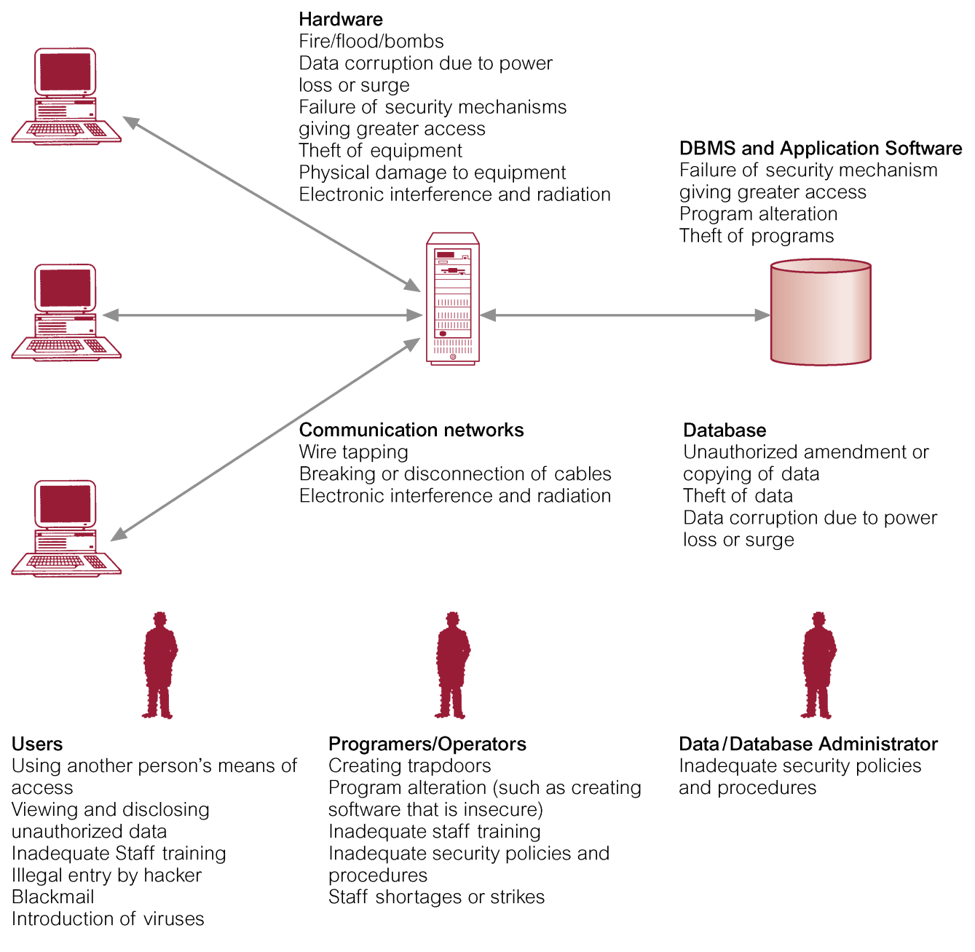
Summary of Threats to Computer Systems
Pearson Education © 2009

Slide 9
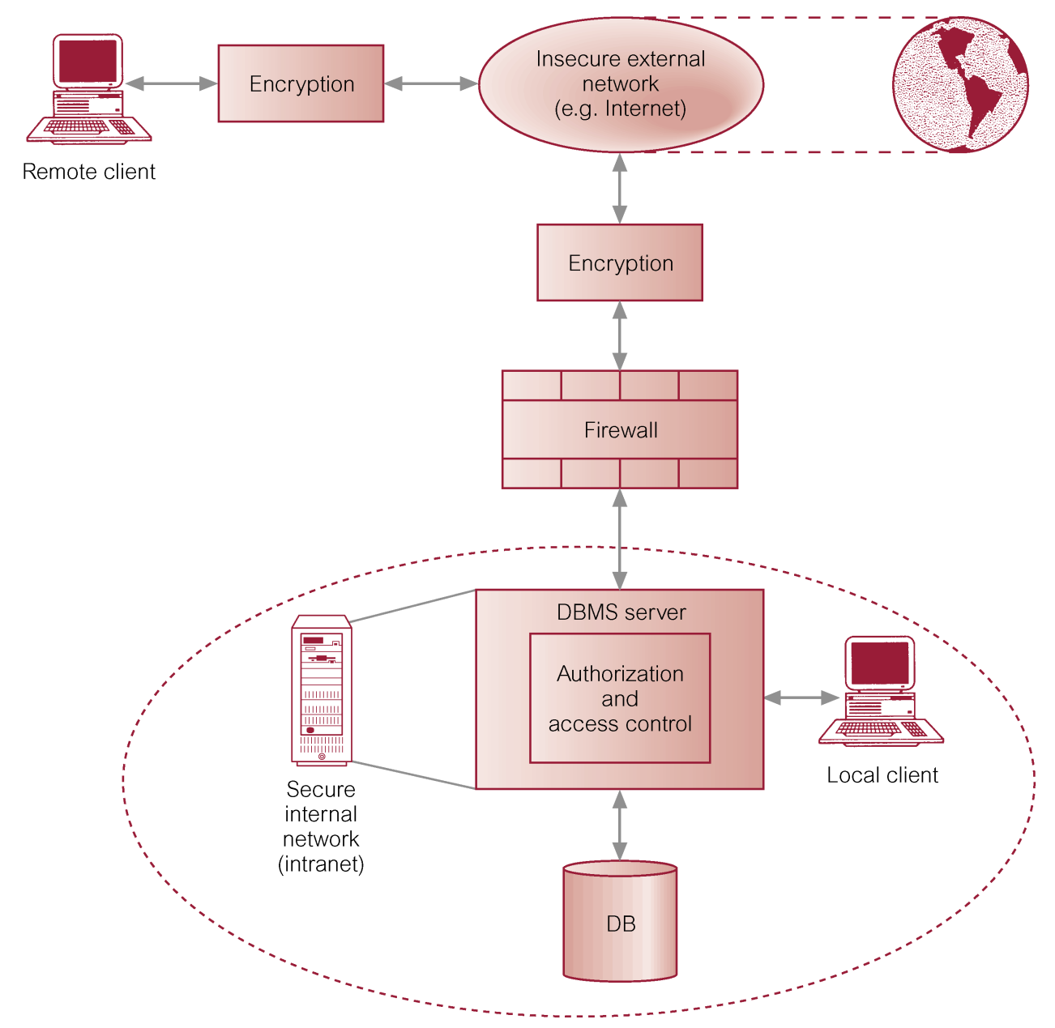
Typical Multi-user Computer Environment
Pearson Education © 2009

Slide 10
Countermeasures – Computer-Based Controls
Concerned with physical controls to administrative procedures and includes:
Authorization
Access controls
Views
Backup and recovery
Integrity
Encryption
RAID technology
Pearson Education © 2009

Slide 11
Countermeasures – Computer-Based Controls
Authorization
The granting of a right or privilege, which enables a subject to legitimately have access to a system or a system’s object.
Authorization is a mechanism that determines whether a user is, who he or she claims to be.
Pearson Education © 2009

Slide 12
Countermeasures – Computer-Based Controls
Access control
Based on the granting and revoking of privileges.
A privilege allows a user to create or access (that is read, write, or modify) some database object (such as a relation, view, and index) or to run certain DBMS utilities.
Privileges are granted to users to accomplish the tasks required for their jobs.
Pearson Education © 2009

Slide 13
Countermeasures – Computer-Based Controls
Most DBMS provide an approach called Discretionary Access Control (DAC).
SQL standard supports DAC through the GRANT and REVOKE commands.
The GRANT command gives privileges to users, and the REVOKE command takes away privileges.
Pearson Education © 2009

Slide 14
Countermeasures – Computer-Based Controls
DAC while effective has certain weaknesses. In particular an unauthorized user can trick an authorized user into disclosing sensitive data.
An additional approach is required called Mandatory Access Control (MAC).
Pearson Education © 2009

Slide 15
Countermeasures – Computer-Based Controls
DAC based on system-wide policies that cannot be changed by individual users.
Each database object is assigned a security class and each user is assigned a clearance for a security class, and rules are imposed on reading and writing of database objects by users.
Pearson Education © 2009

Slide 16
Countermeasures – Computer-Based Controls
DAC determines whether a user can read or write an object based on rules that involve the security level of the object and the clearance of the user. These rules ensure that sensitive data can never be ‘passed on’ to another user without the necessary clearance.
The SQL standard does not include support for MAC.
Pearson Education © 2009

Slide 17
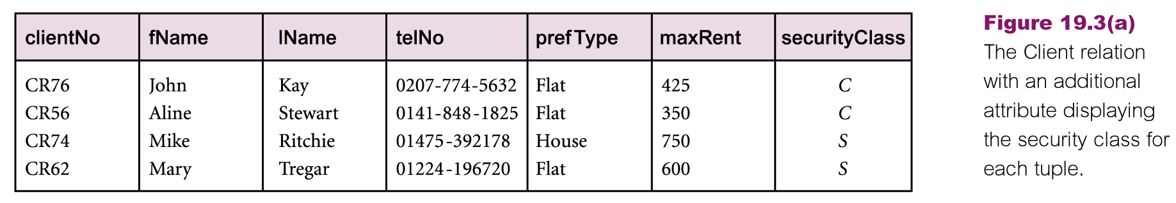
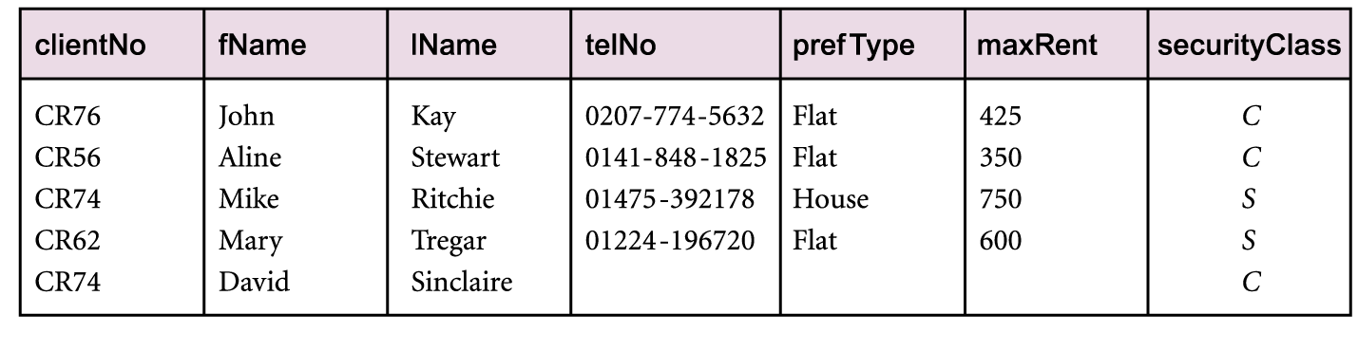
Popular Model for MAC called Bell-LaPudula
Pearson Education © 2009

Slide 18
Countermeasures – Computer-Based Controls
View
Is the dynamic result of one or more relational operations operating on the base relations to produce another relation.
A view is a virtual relation that does not actually exist in the database, but is produced upon request by a particular user, at the time of request.
Pearson Education © 2009

Slide 19
Countermeasures – Computer-Based Controls
Backup
Process of periodically taking a copy of the database and log file (and possibly programs) to offline storage media.
Journaling
Process of keeping and maintaining a log file (or journal) of all changes made to database to enable effective recovery in event of failure.
Pearson Education © 2009

Slide 20
Countermeasures – Computer-Based Controls
Integrity
Prevents data from becoming invalid, and hence giving misleading or incorrect results.
Encryption
The encoding of the data by a special algorithm that renders the data unreadable by any program without the decryption key.
Pearson Education © 2009

Slide 21
RAID (Redundant Array of Independent Disks) Technology
Hardware that the DBMS is running on must be fault-tolerant, meaning that the DBMS should continue to operate even if one of the hardware components fails.
Suggests having redundant components that can be seamlessly integrated into the working system whenever there is one or more component failures.
Pearson Education © 2009

Slide 22
RAID (Redundant Array of Independent Disks) Technology
The main hardware components that should be fault-tolerant include disk drives, disk controllers, CPU, power supplies, and cooling fans.
Disk drives are the most vulnerable components with the shortest times between failure of any of the hardware components.
Pearson Education © 2009

Slide 23
RAID (Redundant Array of Independent Disks) Technology
One solution is to provide a large disk array comprising an arrangement of several independent disks that are organized to improve reliability and at the same time increase performance.
Pearson Education © 2009

Slide 24
RAID (Redundant Array of Independent Disks) Technology
Performance is increased through data striping: the data is segmented into equal-size partitions (the striping unit), which are transparently distributed across multiple disks.
Reliability is improved through storing redundant information across the disks using a parity scheme or an error-correcting scheme.
Pearson Education © 2009

Slide 25
RAID (Redundant Array of Independent Disks) Technology
There are a number of different disk configurations called RAID levels.
RAID 0 Nonredundant
RAID 1 Mirrored
RAID 0+1 Nonredundant and Mirrored
RAID 2 Memory-Style Error-Correcting Codes
RAID 3 Bit-Interleaved Parity
RAID 4 Block-Interleaved Parity
RAID 5 Block-Interleaved Distributed Parity
RAID 6 P+Q Redundancy
Pearson Education © 2009

Slide 26
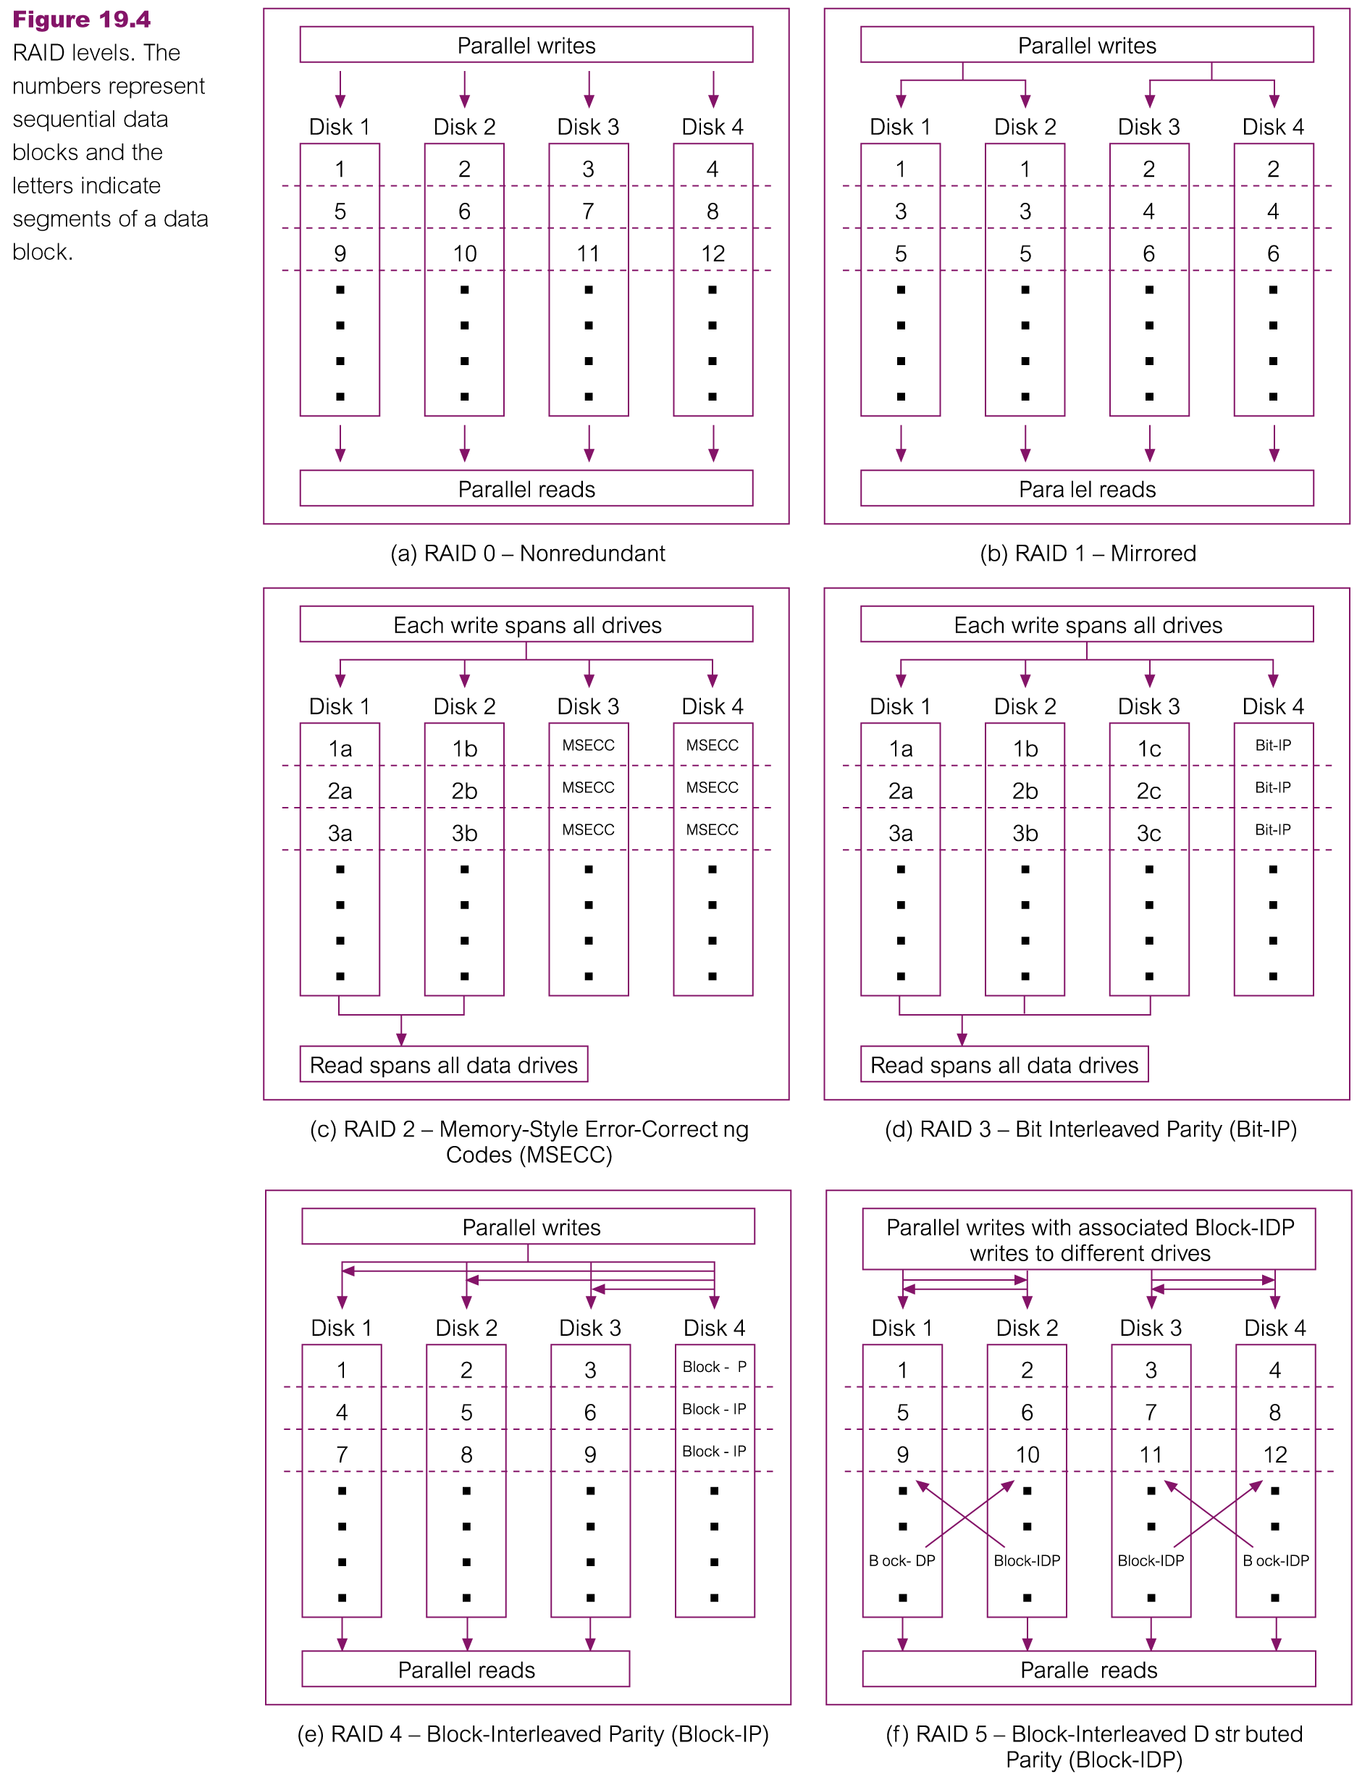
RAID 0 and RAID 1
Pearson Education © 2009

Slide 27
RAID 2 and RAID 3
Pearson Education © 2009

Slide 28
RAID 4 and RAID 5
Pearson Education © 2009

Slide 29
Security in Microsoft Office Access DBMS
Provides two methods for securing a database:
setting a password for opening a database (system security);
user-level security, which can be used to limit the parts of the database that a user can read or update (data security).
Pearson Education © 2009

Slide 30
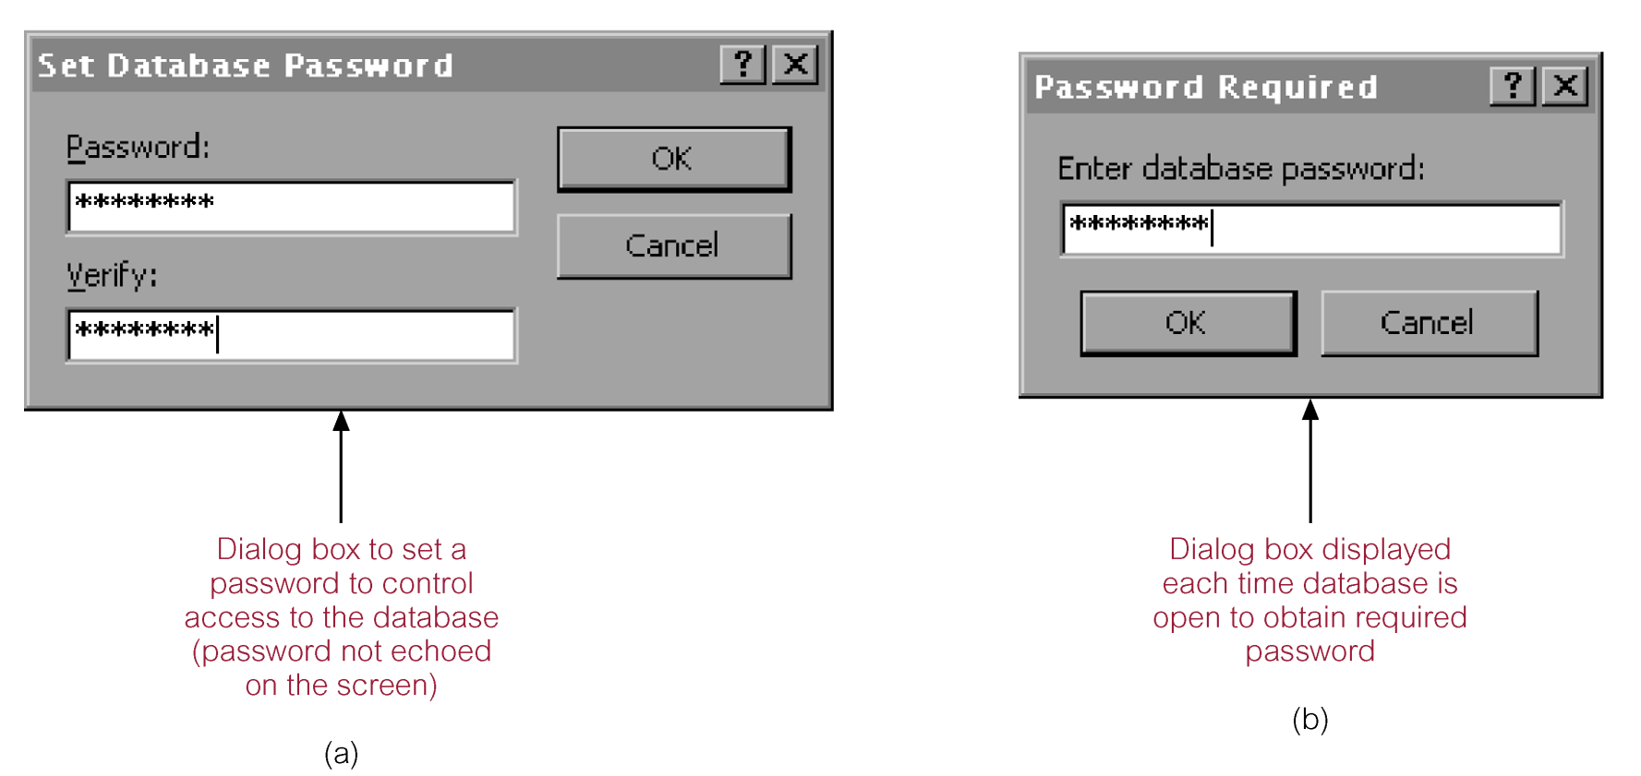
Securing the DreamHome database using a password
Pearson Education © 2009

Slide 31
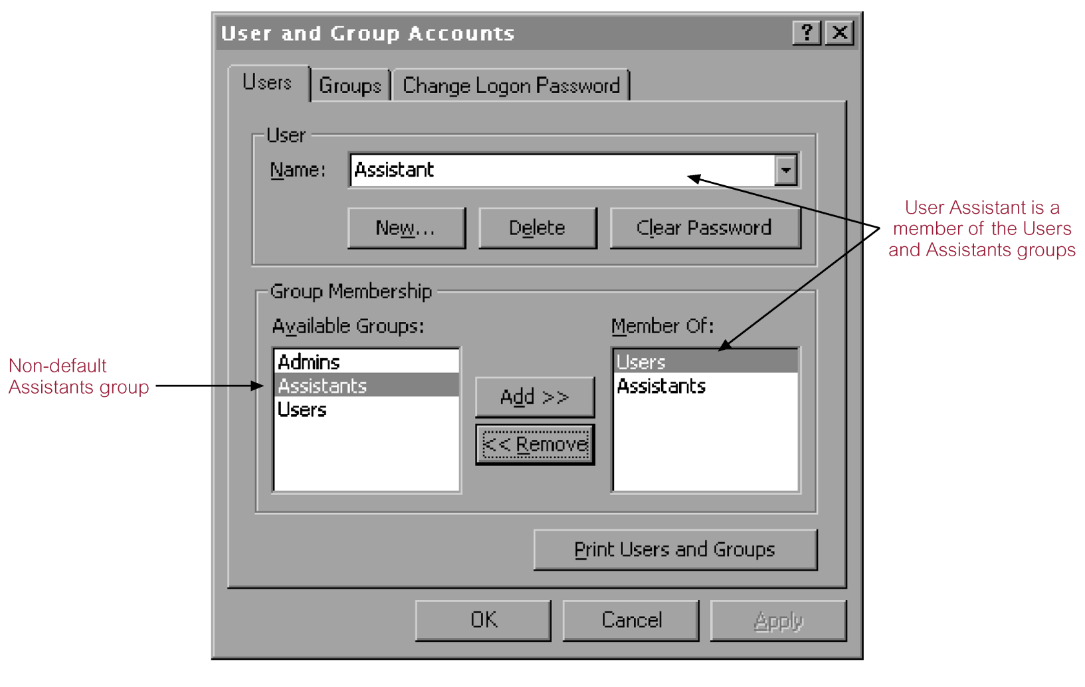
User and Group Accounts dialog box for the DreamHome database
Pearson Education © 2009

Slide 32
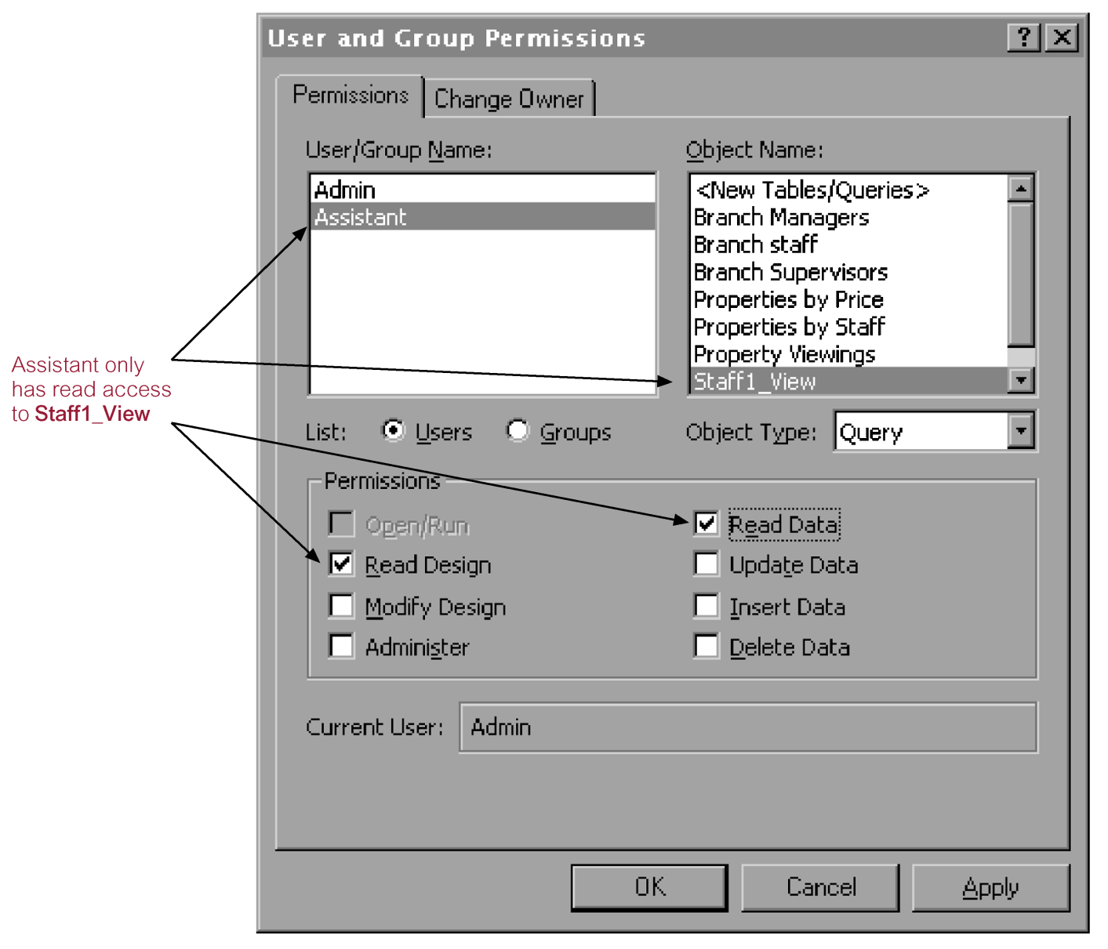
User and Group Permissions dialog box
Pearson Education © 2009

Slide 33
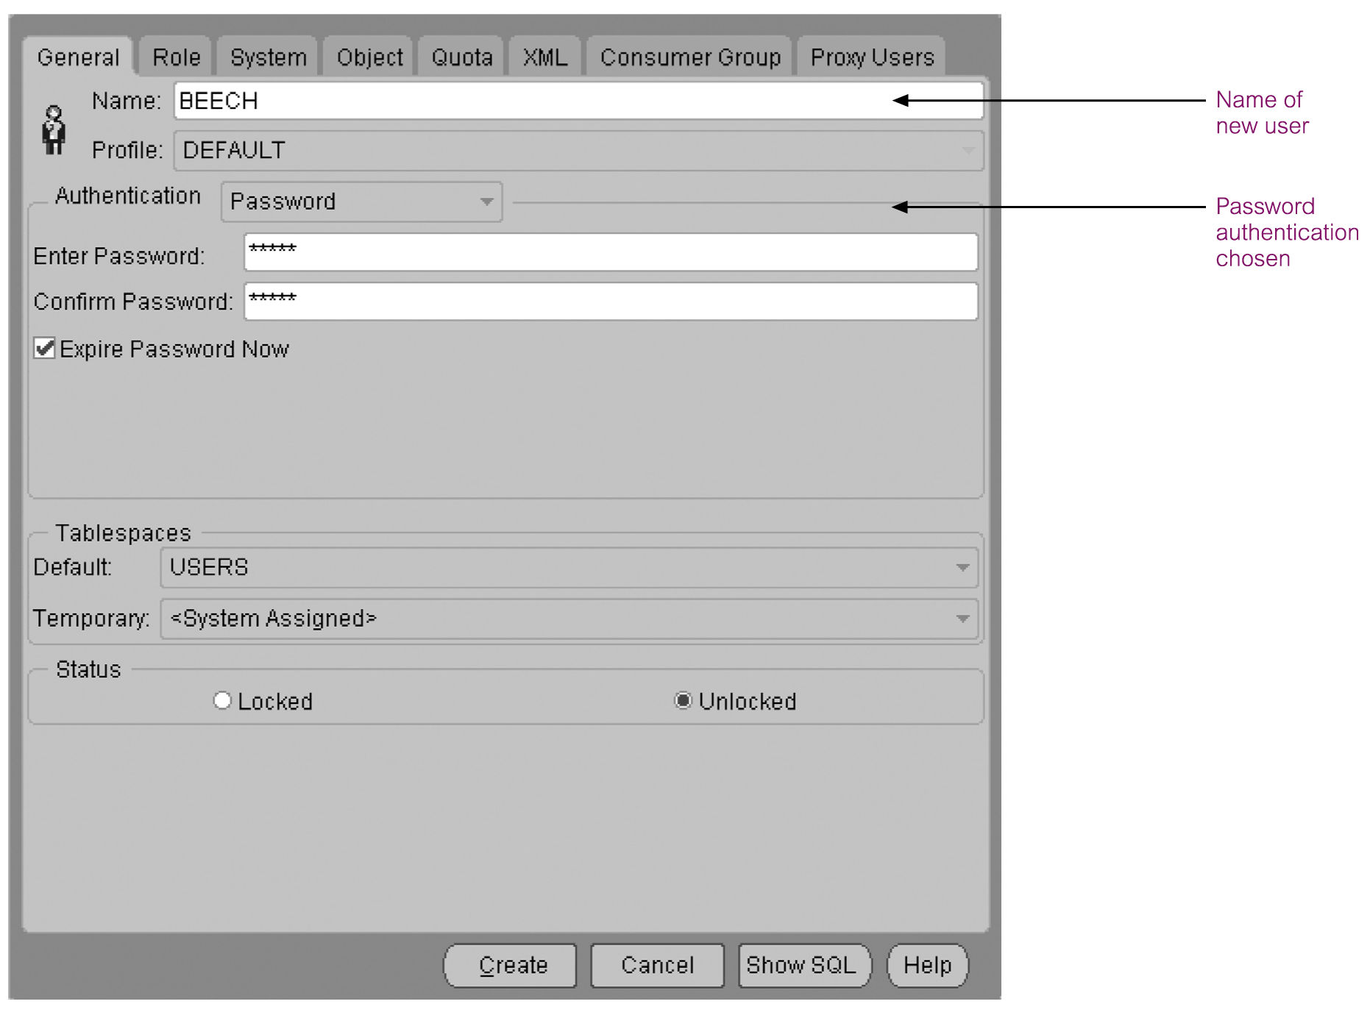
Creation of a new user with password authentication set
Pearson Education © 2009

Slide 34
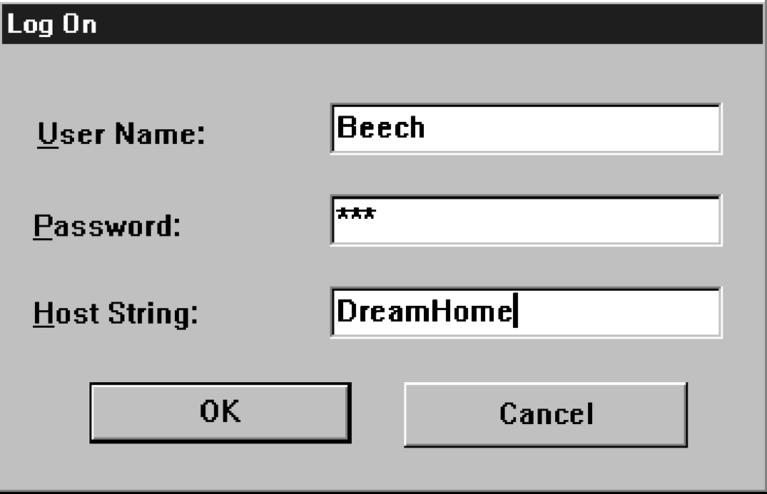
Log on dialog box
Pearson Education © 2009

Slide 35
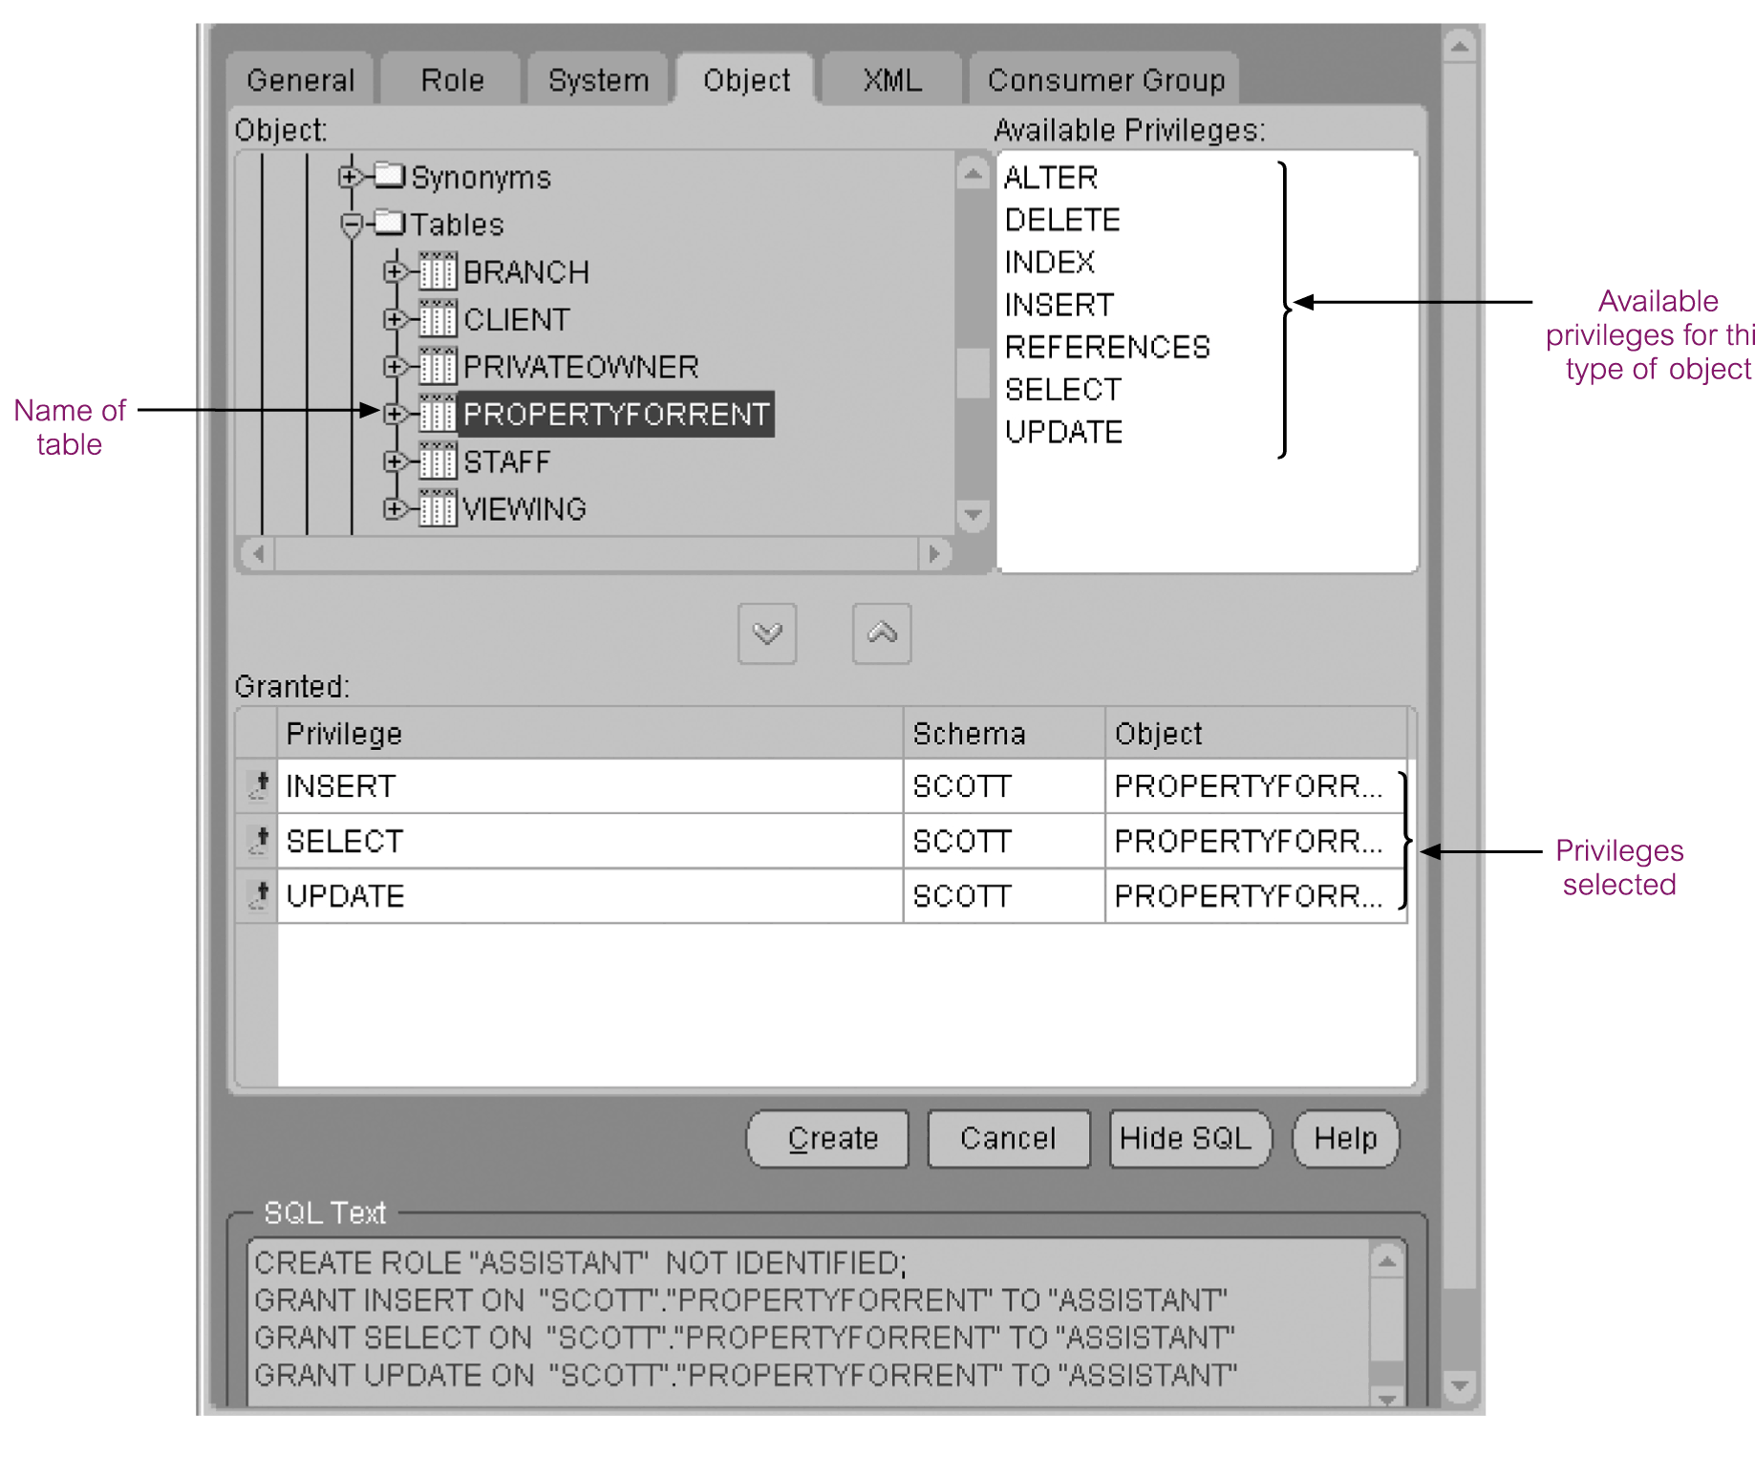
Setting the Insert, Select, and Update privileges
Pearson Education © 2009

Slide 36
DBMSs and Web Security
Internet communication relies on TCP/IP as the underlying protocol. However, TCP/IP and HTTP were not designed with security in mind. Without special software, all Internet traffic travels ‘in the clear’ and anyone who monitors traffic can read it.
Pearson Education © 2009

Slide 37
DBMSs and Web Security
Must ensure while transmitting information over the Internet that:
inaccessible to anyone but sender and receiver (privacy);
not changed during transmission (integrity);
receiver can be sure it came from sender (authenticity);
sender can be sure receiver is genuine (non-fabrication);
sender cannot deny he or she sent it (non-repudiation).
Pearson Education © 2009

Slide 38
DBMSs and Web Security
Measures include:
Proxy servers
Firewalls
Message digest algorithms and digital signatures
Digital certificates
Kerberos
Secure sockets layer (SSL) and Secure HTTP (S-HTTP)
Secure Electronic Transactions (SET) and Secure Transaction Technology (SST)
Java security
ActiveX security
Pearson Education © 2009

Slide 39
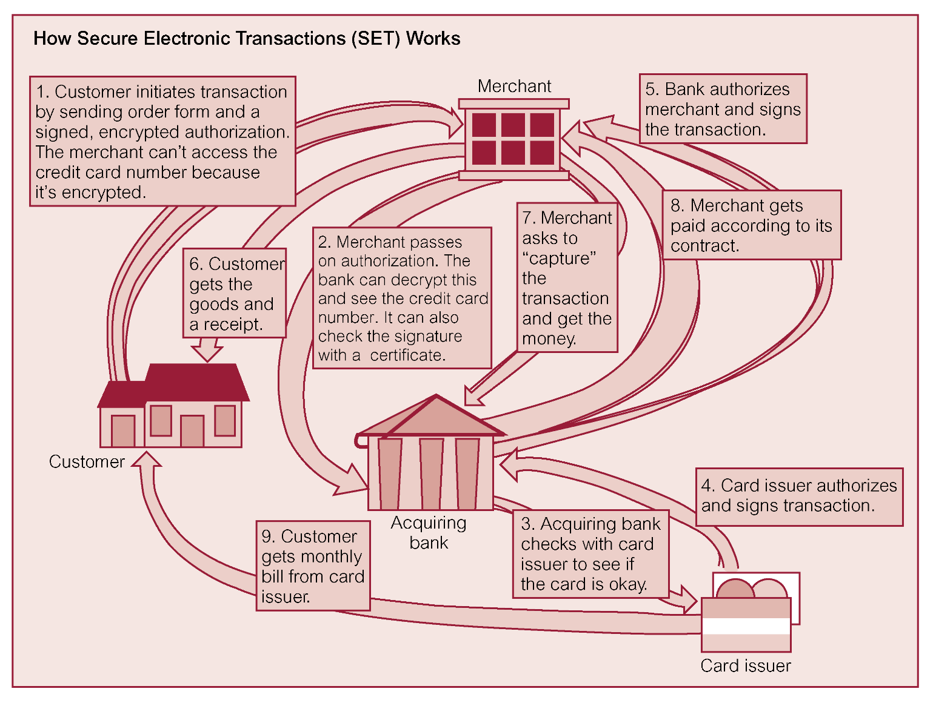
How Secure Electronic Transactions (SET) Works
Pearson Education © 2009

